Slide 1
Android PHP from MySQL
Arc Chang
2016/08/17

Slide 2
Outline
Introduction
Volley – Http Request Framework
Implement
Select
Insert
Update
Delete
Special case
Image
Array
Example
Reference

Slide 3
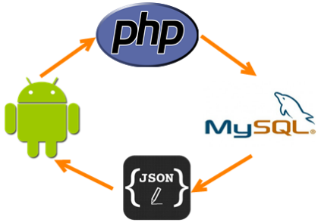
Introduction
For Android SQLite database, we can handle the table easily
But it can’t share with other applications
So we should use our local or cloud databases
In order to access them,
Write PHP code
Implement GET or POST method
Change MySQL database’s data into JSON format

Slide 4

Use Android Library to handle the GET or POST request
HttpClient
Was removed at Android 6.0
https://developer.android.com/about/versions/marshmallow/android-6.0-changes.html#behavior-apache-http-client
HttpURLConnection
Has some bugs before Android 2.2
Can’t be used in Main Thread
https://code.google.com/p/android/issues/details?id=2939
Volley
Bad in large data
transmission
Easy to use!

Slide 5

Volley
At Google I/O 2013
Volley: Easy,Fast Networking for Android
Developer Ficus Kirkpatrick
Volley, a library that makes it really easy to build super-fast networked applications for Android

Slide 6
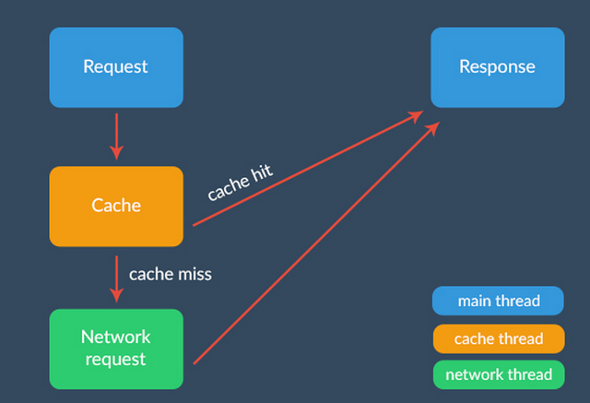
Framework
To see more details, click the link below the image
From：http://code.tutsplus.com/tutorials/an-introduction-to-volley--cms-23800

Slide 7
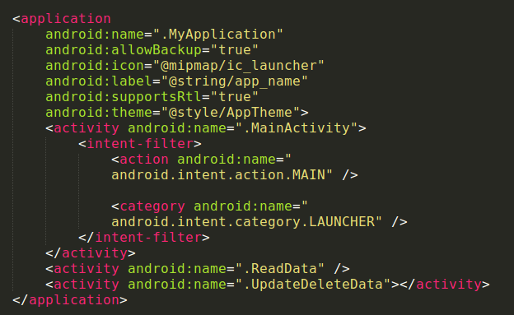
Implement
Gradle
compile 'com.mcxiaoke.volley:library:1.0.19'
AndroidManifest.xml
<uses-permission android:name="android.permission.CHANGE_NETWORK_STATE" />
<uses-permission android:name="android.permission.INTERNET" />
Add an Application class
In order to make all
activities used the
global variables

Slide 8
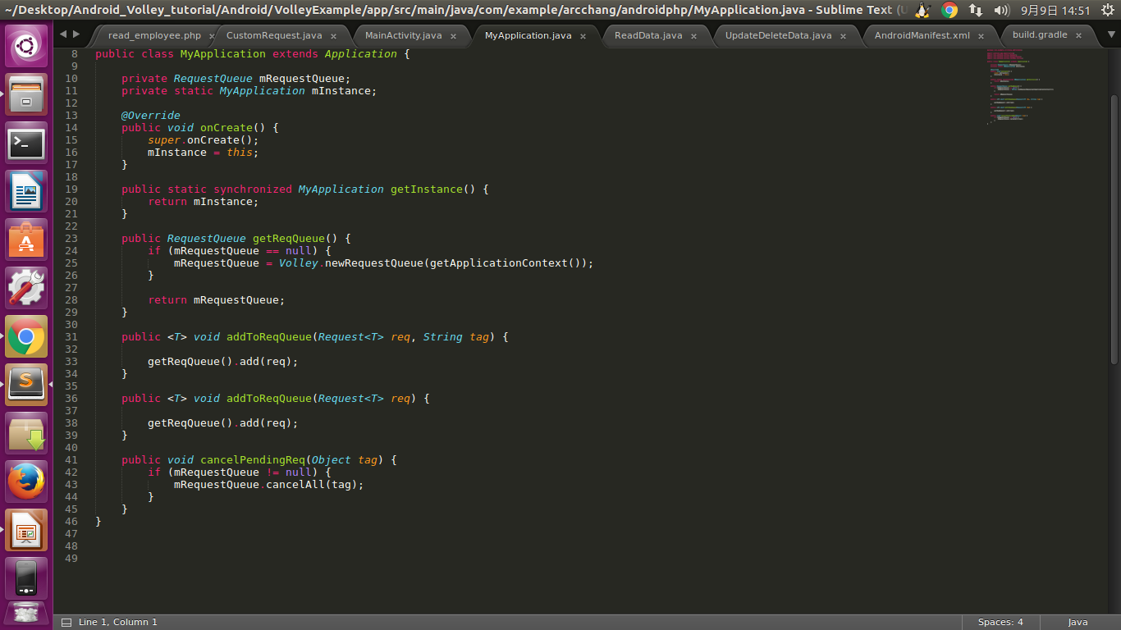
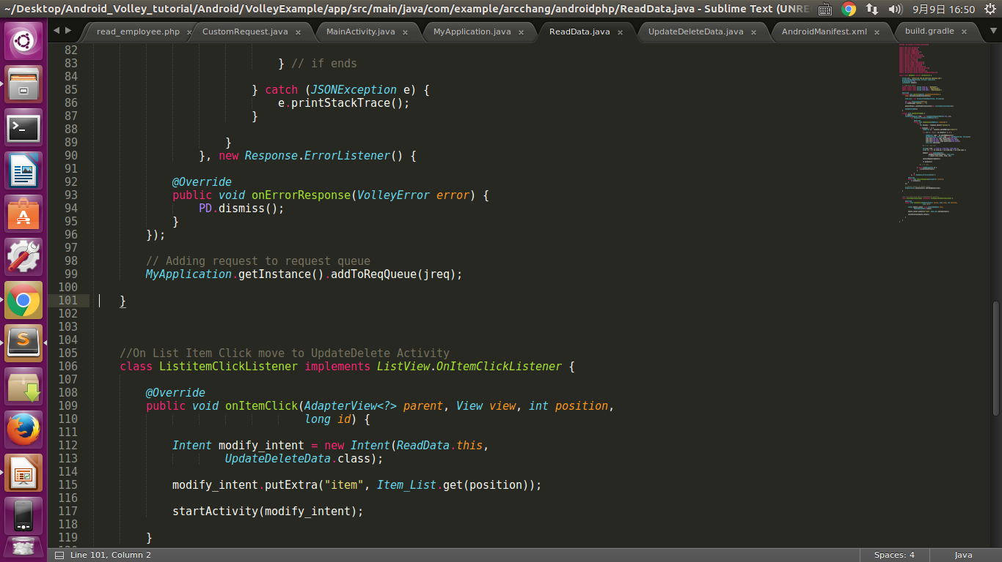
MyApplication.java
Step to use Volley
New a RequestQueue
New a request
String
JSONObject
Image
Add request to
RequestQueue

Slide 9
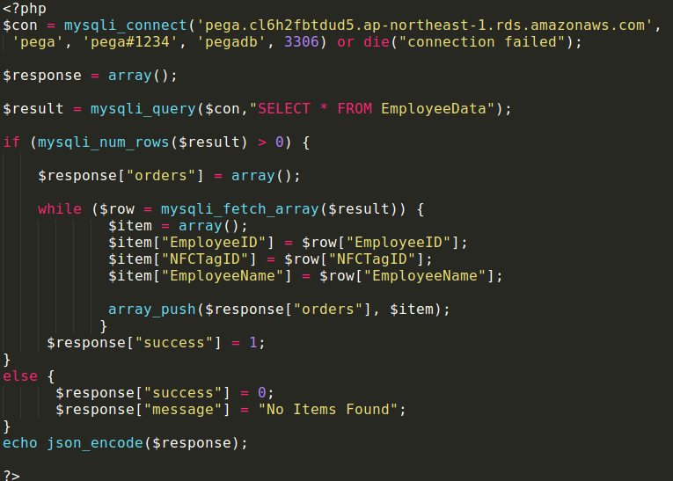
Implement – Select
PHP
read_employee.php

Slide 10
PHP

Slide 11
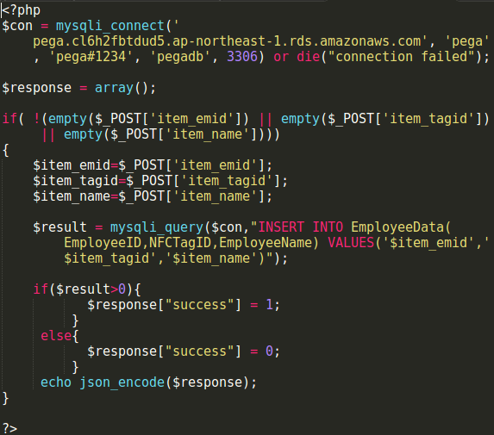
Implement – Insert
PHP
insert_man.php

Slide 12
PHP

Slide 13
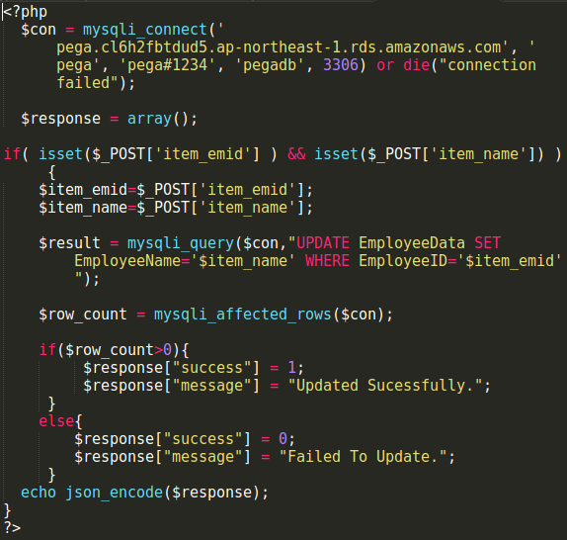
Implement – Update
PHP
update.php

Slide 14
PHP

Slide 15
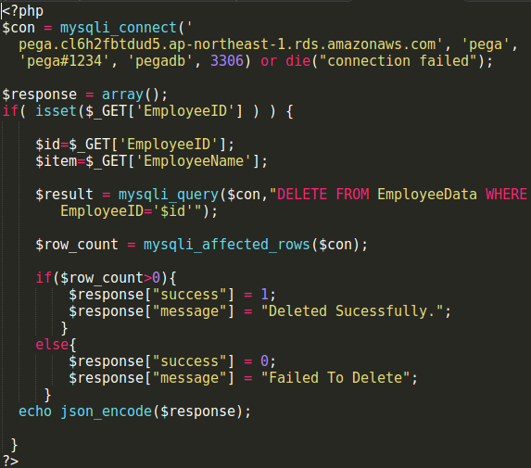
Implement – Delete
PHP
delete.php

Slide 16
PHP

Slide 17
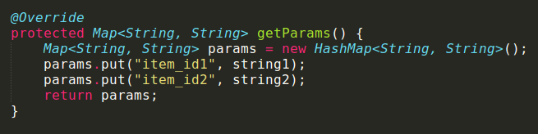
Special case
We can use JsonObjectRequest to upload JSON format data to our database
However, cause we need to connect the database through POST request
Volley provides getParams() method to implement
And the type is String only
Thus, we must change any type of data into “String”

Slide 18
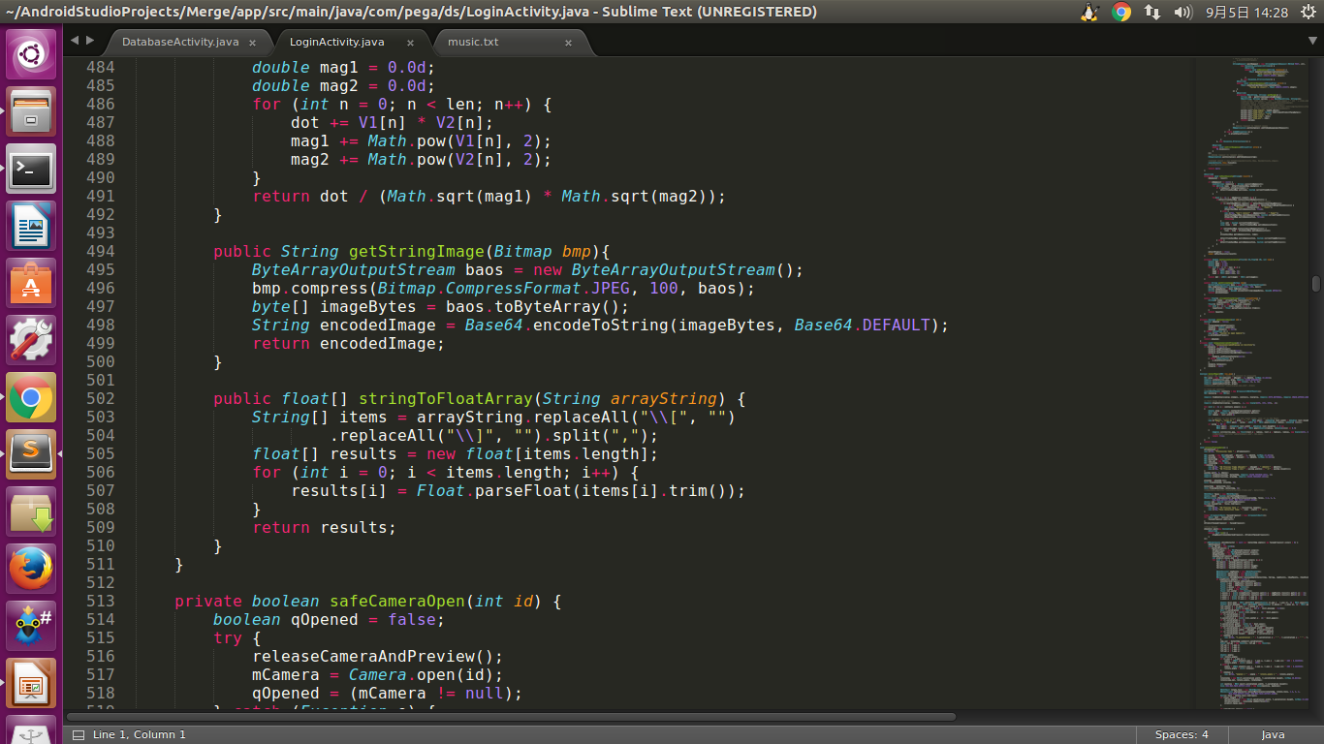
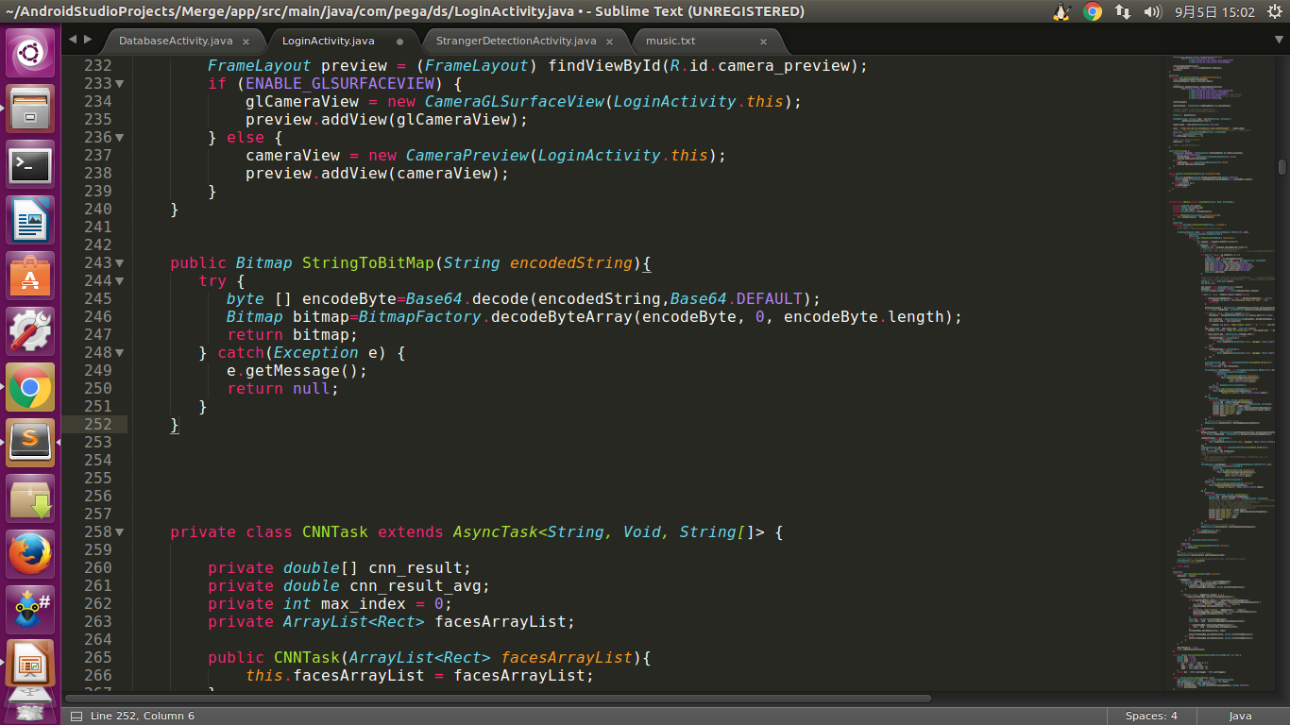
Special case – Image
For Bitmap to String
Compress bitmap first and then change into byte[ ]
Use Base64 to encode the byte[ ] to String
For String to Bitmap
vice versa

Slide 19
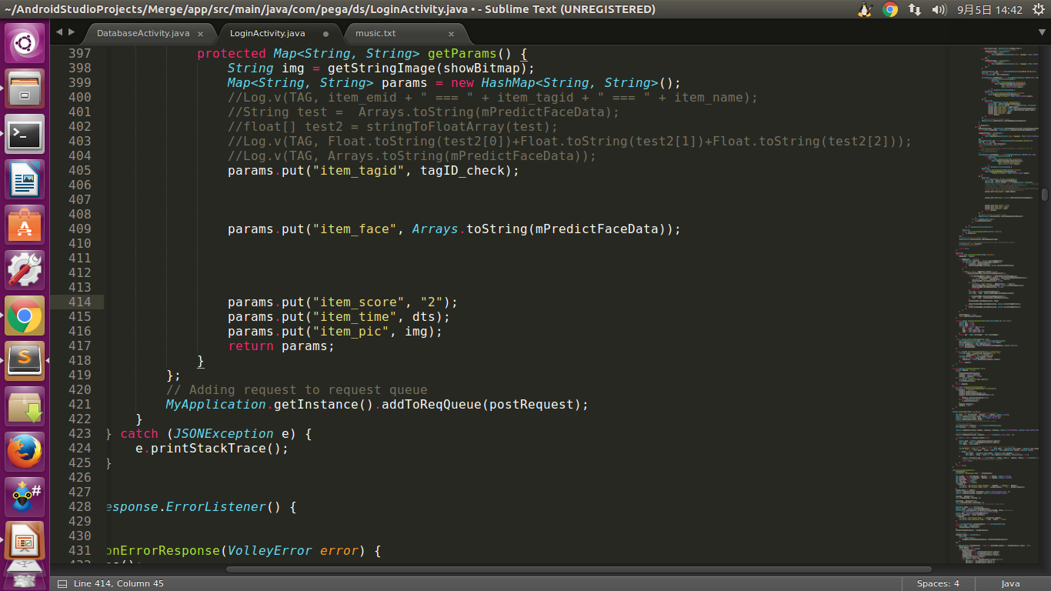
Special case – Array
For array to String
If float[] mPredictFaceData = {4.8, 5.2, 0, 6.5};
We will get String ans = [4.8, 5.2, 0, 6.5];
For String to array
Split the String first
Then use parse to change type of data one by one

Slide 20

Example
GO to my GitHub and git clone the repository
Android_Volley_tutorial
https://github.com/arcprince1236/Android_Volley_tutorial

Slide 21
Reference
https://blog.ccjeng.com/2015/08/Android-Volley.html
http://in.gururu.tw/2013/09/Volley-HTTP-Library-for-Android.html
Image
http://stackoverflow.com/questions/13562429/how-many-ways-to-convert-bitmap-to-string-and-vice-versa
String
http://www.ewdna.com/2012/02/javaarray-to-string-string-to-array.htm
http://code.tutsplus.com/tutorials/an-introduction -to-volley--cms-23800

Slide 22

Thanks

